Slide 1







OBJECTIVE(s)
HEALTH - An active cyclist wanting to go for bike rides that also crosses over hawker places at rest stops
CARE - Wanting to send an elderly parent to clinics but also managing an active child at the same near mealtime, which area would likely be your best bet?

Slide 2


OBJECTIVE(s)
HEALTH - An active cyclist wanting to go for bike rides that also crosses over hawker places at rest stops
CARE - Wanting to send an elderly parent to clinics but also managing an active child at the same near mealtime, which area would likely be your best bet?
HACK for {GOOD|LIFE}
We aim to bring this chatbot to allow Singaporeans, locals and visitors alike to be able to benefit from planning their visits to areas based on their interests.
Be it MEDICAL, SPORTS, MEALS, CHILDCARE and SERVICES, the solution will help provide recommendations on where to visit or even life planning in the future.

Slide 3
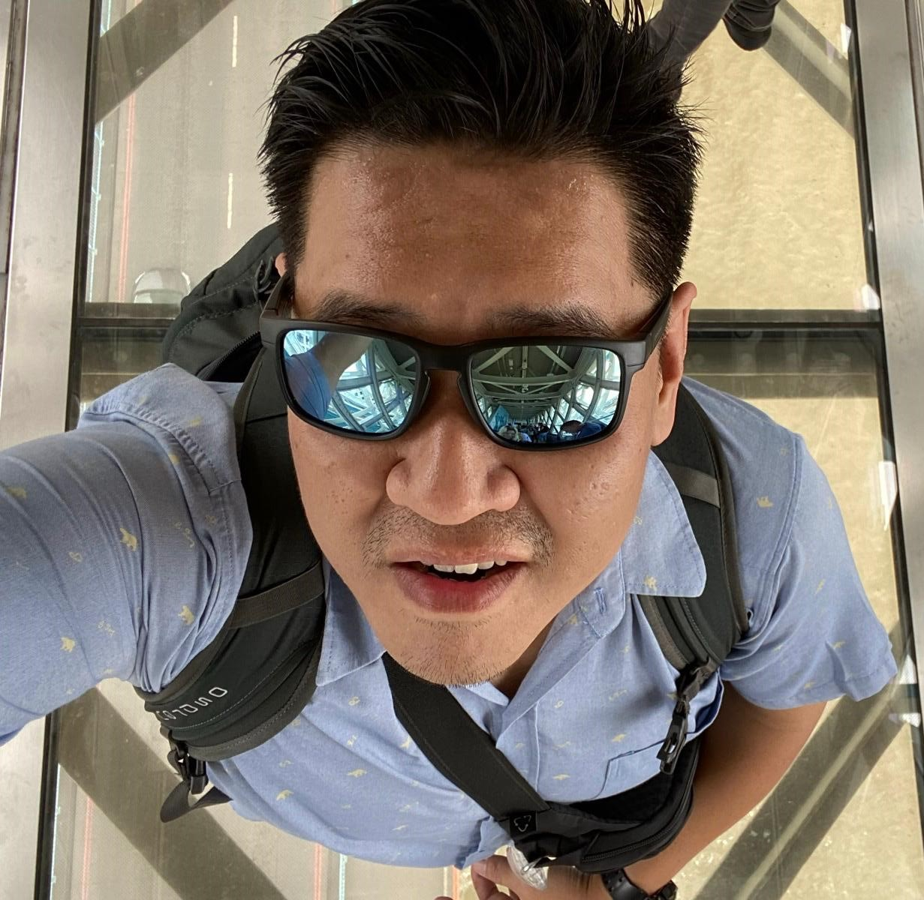
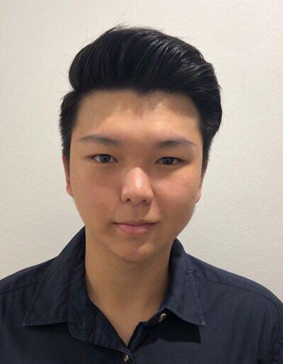
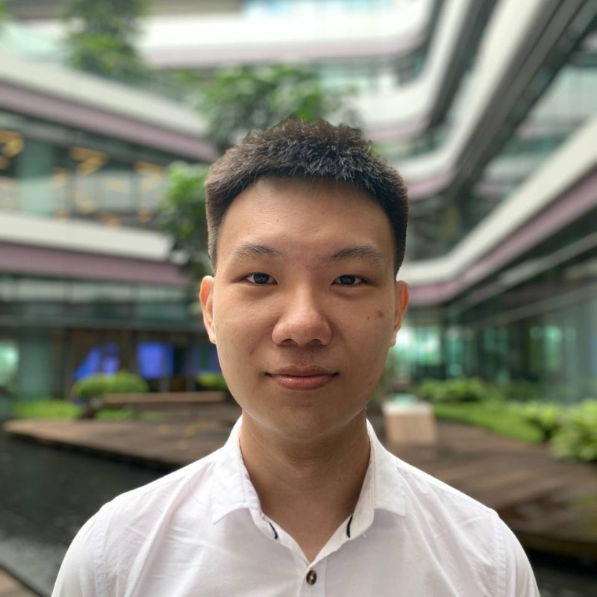
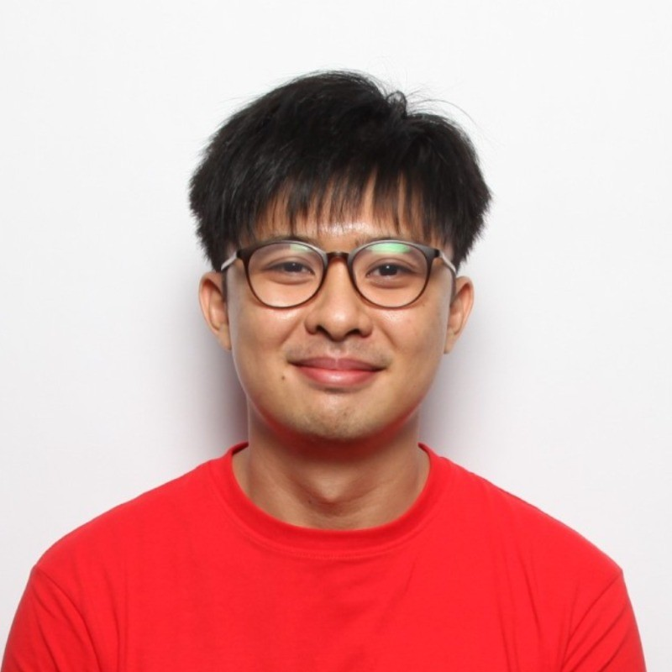
OBJECTIVE(s)
HEALTH - An active cyclist wanting to go for bike rides that also crosses over hawker places at rest stops
CARE - Wanting to send an elderly parent to clinics but also managing an active child at the same near mealtime, which area would likely be your best bet?
HACK for {GOOD|LIFE}
We aim to bring this chatbot to allow Singaporeans, locals and visitors alike to be able to benefit from planning their visits to areas based on their interests.
Be it MEDICAL, SPORTS, MEALS, CHILDCARE and SERVICES, the solution will help provide recommendations on where to visit or even life planning in the future.
“Janitor” - Nic
“GFX” - Dylan
“Lead” - YK
“Co-lead” - JT

Slide 4

HACK-FOR-GOOD
MEET THE TEAM
“Lead” - YK
“Co-lead” - JT
“Janitor” - Nic
“GFX” - Dylan
IDEATION
What are the available data sources today?
Social Services
Clinics
Parks
Childcare
Hawker Centers
Supermarkets
Cycling Paths etc

Slide 5
IDEATION
What are the available data sources today?
Social Services
Clinics
Parks
Childcare
Hawker Centers
Supermarkets
Cycling Paths etc
IDEATION - FUTURE
Imagine getting housing information (public and private) and make a determination that affects your lifestyle in the future … just by asking
- Where would be the best place for a family of 5 with an elder parent and 2 active kids who enjoys cycling near supermarkets and hawker center

Slide 6
IDEATION
What are the available data sources today?
Social Services
Clinics
Parks
Childcare
Hawker Centers
Supermarkets
Cycling Paths etc
IDEATION - FUTURE
Imagine getting housing information (public and private) and make a determination that affects your lifestyle in the future … just by asking
- Where would be the best place for a family of 5 with an elder parent and 2 active kids who enjoys cycling near supermarkets and hawker center

Slide 7
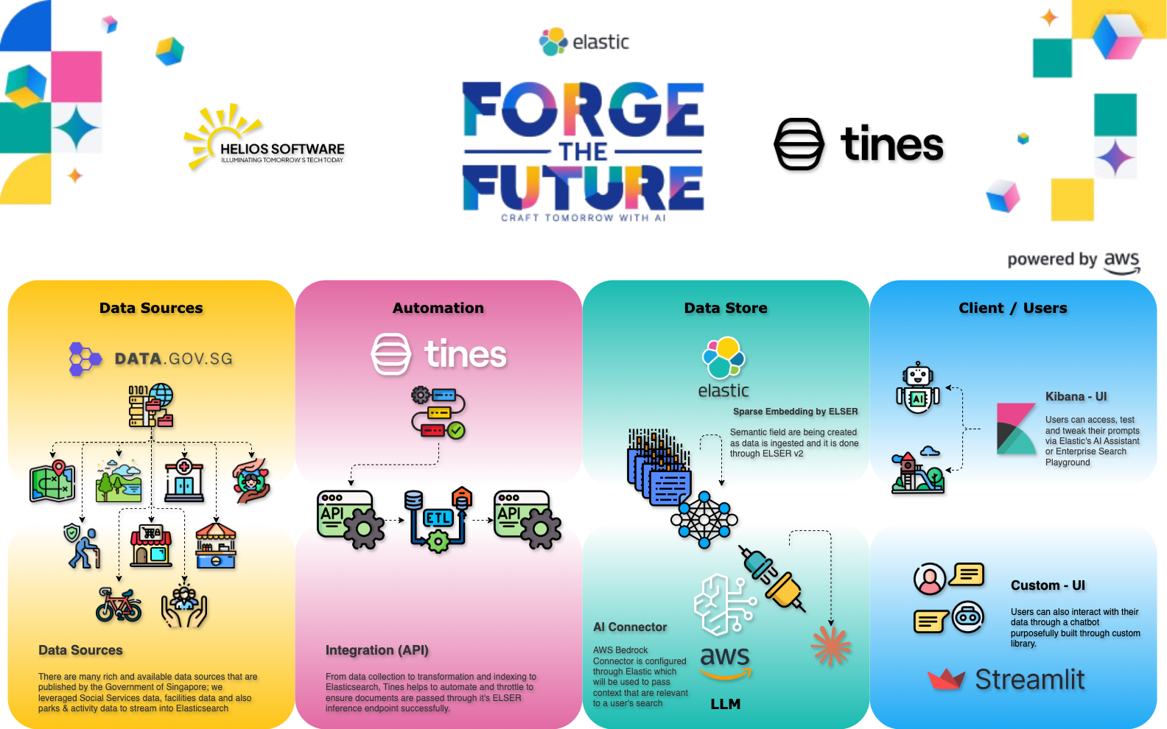
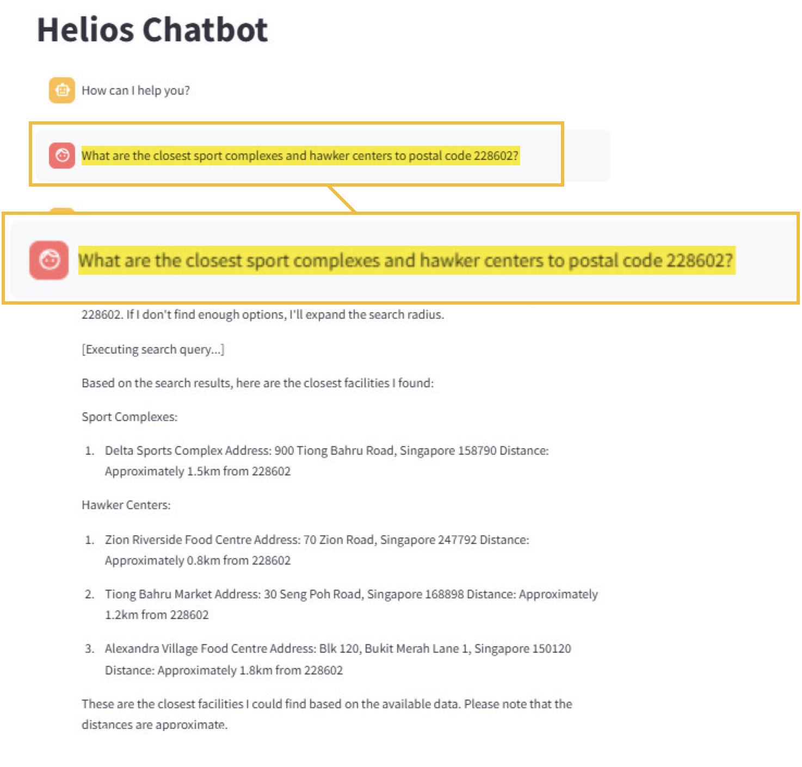
Our “FIRST” take
LIVE DEMO

Slide 8

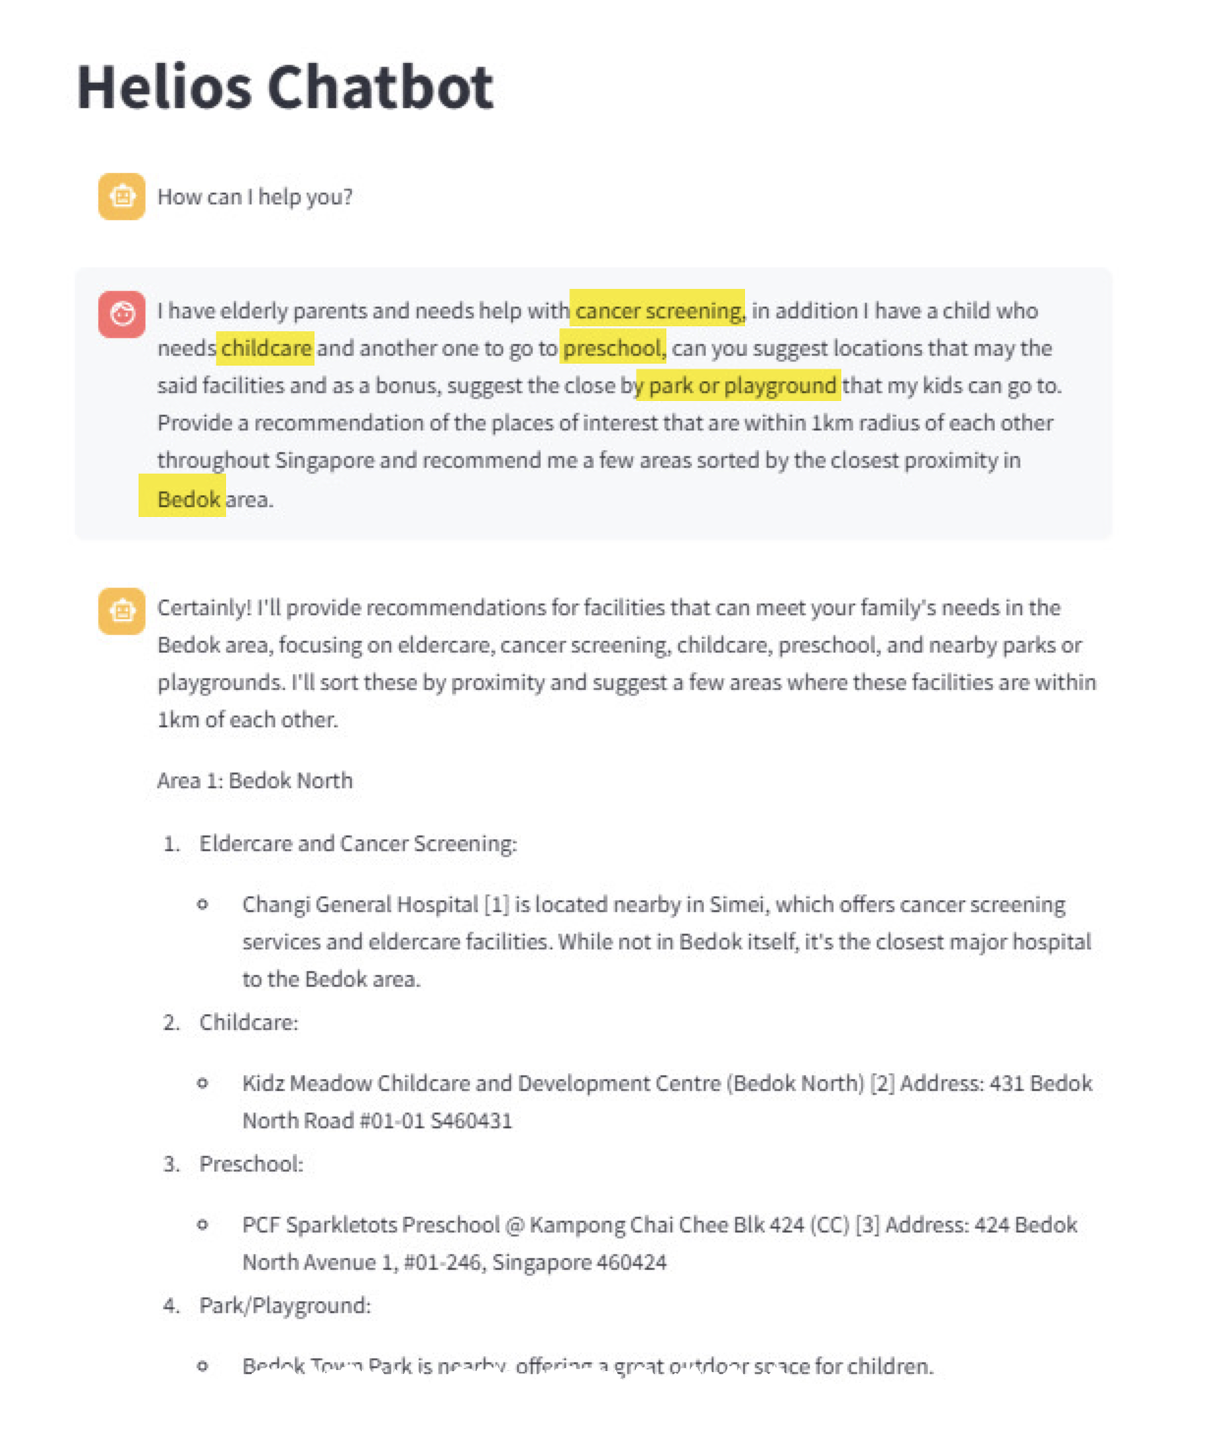
Our “FIRST” take
LIVE DEMO
Notes:
Prompt: What are the closest sport complexes and hawker centers to postal code 228602?

Slide 9
LIVE DEMO
LIVE DEMO
Notes:
Prompt: I have elderly parents and needs help with cancer screening, in addition I have a child who needs childcare and another one to go to preschool, can you suggest locations that may the said facilities and as a bonus, suggest the close by park or playground that my kids can go to. Provide a recommendation of the places of interest that are within 1km radius of each other throughout Singapore and recommend me a few areas sorted by the closest proximity in Bedok area. ⁠

Slide 10
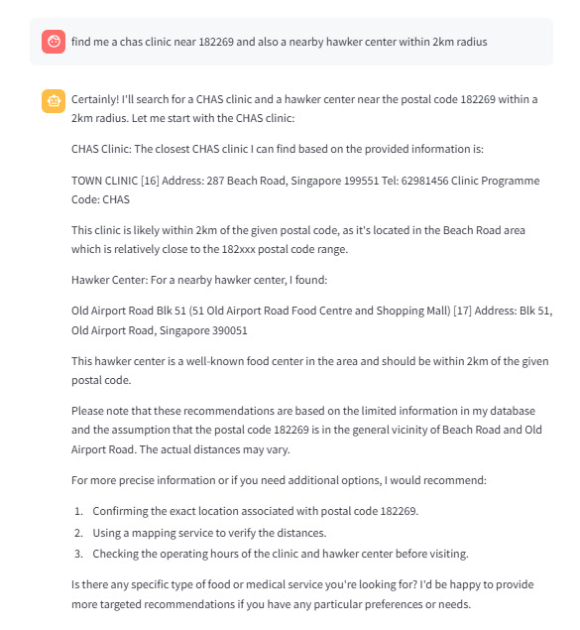
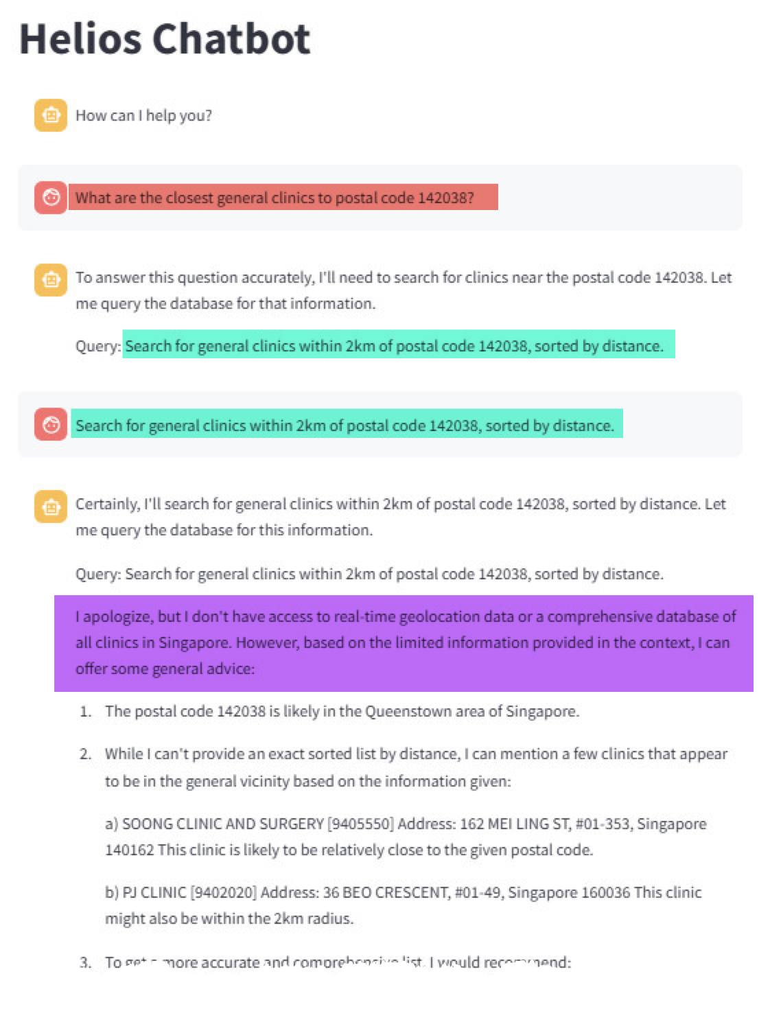
LIVE DEMO
Find a clinic near a hawker center
AREAS to IMPROVE

Slide 11



LIVE DEMO
Find a clinic near a hawker center
AREAS to IMPROVE
THANK YOU SPONSORS!
Notes:
Prompt: What are the closest general clinics to postal code 142038

Slide 12




LIVE DEMO
Find a clinic near a hawker center
THANK YOU SPONSORS!

